Slide 1

شركة فارما لصناعة منتجات
الكاوتشوك والبلاستك
تأسست شركة فارما سنة 1965
رائدة في إنتاج وتوزيع جميع أنواع العبوات البلاستيكية الطبية والصيدلية والتجميلية والبيطرية
أعلى درجات النظافة والاشتراطات الصحية في مناطق تصنيع مدعمة بأرضيات وأسقف مضادة للبكتيريا
منتجات متنوعة من عبوات الكبسولات ، والملاعق بأشكال تتفق مع الاستخدامات والأعمار المختلفة
أجهزة الاستنشاق - بخاخات الربو ـ زجاجات شامبو
وغيرها من المنتجات تغطي احتياجات متنوعة للعملاء

Slide 2

تطبيق اشتراطات الجودة بكفاءة
أسعار تنافسية مناسبة
التزام بتلبية احتياجات العملاء في المواعيد
صحة العميل اهتمامنا الرئيسي
مواد بلاستيكية صحية بكثافات طبية مختلفة طبقا لطبيعة المنتج (بولي إيثيلين PE و بولي بروبلين PP)
مواد خام وألوان طبقاً لمواصفات إدارة الغذاء والدواء FDA
معدات وتكنولوجيا متقدمة (حقْن – نفخ – حقْن نفخ)
عمالة مدْربة وخبرات متراكمة
قوالب واسطمبات متنوعة تواكب احتياجات العملاء
أساليب متنوعة للطباعة
خبرات وإمكانات تصديرية للعالم العربي والأفريقي

Slide 3

Pharma for Rubber & Plastic industries
Established in 1965.
Pharma is a leader company in producing and distributing all kinds of medical, pharmaceutical, cosmetic & veterinary plastic packing such as
* eye droppers - capsules boxes, graded spoons, inhaler actuators, shampoo and lotion bottles
* and other products for wide use.
production takes place in a clean and hygienic area based on antibacterial floor and ceiling
Our main objective is to offer our customers superior quality, competitive pricing, on time delivery and excellent customer service.

Slide 4

Because your health is our main concern; we use hygienic medical grade plastic materials in different density (High, Medium & Low) such as Polyethylene PE, Polypropylene PP, Polystyrene PS & Polyvinyl Chloride PVC.
All raw materials & colors used in production are approved by The Food & Drug Administration (FDA)
Pharma has the most advanced plastic manufacturing equipment, printing and molding machines.

Slide 5
Using high technology
Updated machines such as injection, blowing, injection blowing & rotation operated
Silkscreen and pad print bottles.
Accumulated experiences and well trained professional staff.
Product diversity and moldings according to customer’s needs & specifications.
Export to all Arab and African countries.

Slide 6
Business information:
· Commercial Reg. # 15052
· Industrial Reg. # 18963. 80 (940)
· The Ministry of Industry [Egyptian Organization for
Standardization & Quality Control, EOS]
LICENSE:
· Ministry of Health license # 3/1998 to produce medical &
pharmaceutical packing
Sales mobile # 01222165761

Slide 7
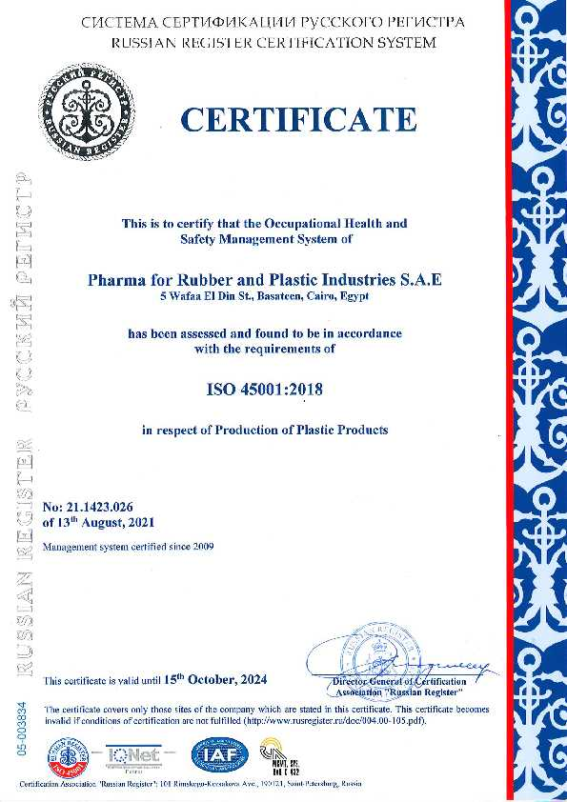

Slide 8
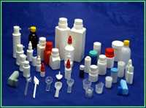
Medical Packing

Slide 9
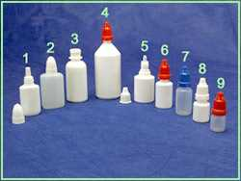
1 | 372 | Dropper 20 ml with nozzle & cap
2 | 371 | Dropper 40 ml with nozzle & cap
3 | 438 | Bottle 30 ml
4 | 420 | Dropper 130 ml with nozzle & proof cap
5 | 359 | Dropper 35 ml with nozzle & proof cap
6 | 436 | Dropper 20 ml with nozzle & proof cap
7 | 357 | Dropper 15 ml with nozzle & proof cap
8 | 356 | Dropper 10 ml with nozzle & proof cap
9 | 355 | Dropper 5 ml with nozzle & proof cap

Slide 10
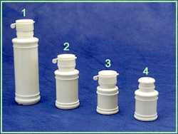
1 | 430 | Capsule box w. soft proof cap
2 | 373 | Capsule box soft proof
3 | 360 | Capsule box soft proof
4 | 360 | Capsule box w.cap

Slide 11
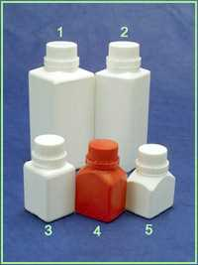
1 | 417 | Plastic box 600 ml with proof cap
2 | 416 | Plastic box 400 ml with proof cap
3 | 415 | Plastic box 120 ml with proof cap
4 | 353 | Capsule box with proof cap (large)
5 | 352 | Capsule box with proof cap (small)

Slide 12
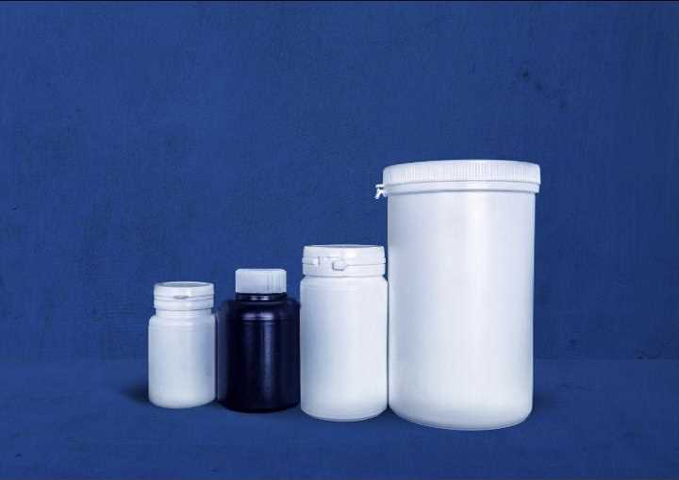
1 | 557 | 60 Capsule Jar
2 | 488 | 200 Capsule Jar
3 | 466 | Jar 1 KG
4 | 560 | Jar 1.5 KG

Slide 13
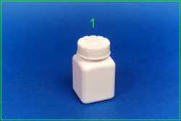
1 | 418 | Capsule box with child proof cap

Slide 14
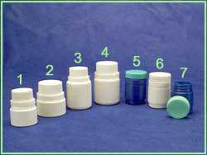
1 | 439 | Capsule box with proof cap small
2 | 397 | Capsule box with proof cap large
3 | 363 | Capsule box medium with proof cap small
4 | 427 | Capsule box with proof cap large
5 & 6 | 385 | Capsule box with screw cap
7 | 526 | Box for capsule or cream with screw cap

Slide 15
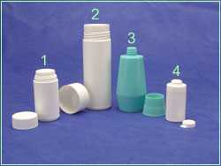
1 | 375 | Powder bottle 65 gm with screw cap
2 | 434 | Powder bottle 100 gm with screw cap
3 | 453 | Soft bottle for cream 120 gm with screw cap
4 | 395 | Powder bottle 35 gm with cap

Slide 16
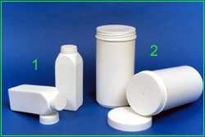
1 | 432 | Powder box with screw cap 50 gm
2 | 468 | Powder box with screw cap 500 gm

Slide 17
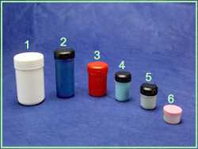
1 | 322 | Plastic box 180 gm
2 | 321 | Plastic box 100 gm
3 | 320 | Plastic box 60 gm
4 | 318 | Plastic box 30 gm
5 | 317 | Plastic box 15 gm
6 | 316 | Plastic box 10 gm

Slide 18
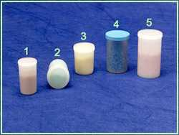
1 | 366 | Plastic box (zero) with cap
2 | 367 | Plastic box (no. 1) with cap
3 | 364 | Plastic box (no. 2) with cap
4 | 365 | Film box
5 | 370 | Plastic box (no. 5) with cap

Slide 19
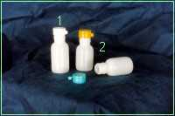
1 | 464 | Filling bottle with proof cap 60 ml
2 | 465 | Filling bottle with proof cap 70 ml

Slide 20
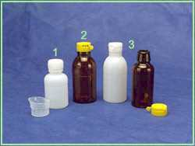
1 | 386 | Antibiotic bottle 80/100 ml with proof cap &measure
2 | 368 | Antibiotic bottle 100/150 ml with proof cap
3 | 369 | Antibiotic bottle 60/80 ml with proof cap

Slide 21
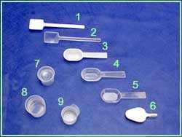
1 & 2 | 510 | Spoon 3.5 ml
3 & 4 & 5 | 506 | Graded spoon 5 ml
6 | 507 | Graded spoon 3.5 ml
7 | 387 | Measure 5 ml
8 | 358 | Measure (5 &10 ml)
9 | 361 | Measure (up to 10 ml)
Spoons could be made of different materials (PE, P.S & P.P)

Slide 22
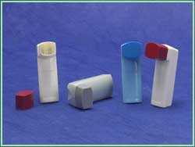
384 | Asthma Inhaler

Slide 23
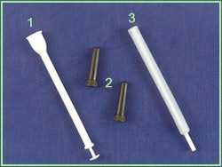
1 | 328 | Vaginal actuator for tablets
2 | 509 | Rectum actuator for cream
3 | 329 | Vaginal actuator for cream

Slide 24
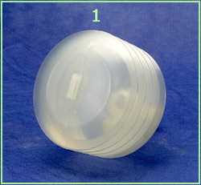
1 | 508 | Blood suction drain

Slide 25
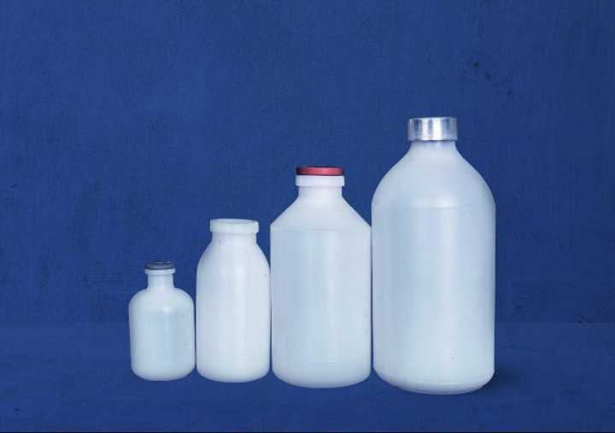
1 | 412 | Nutrient Solution bottle 500 ml
2 | 463 | Nutrient Solution bottle 300 ml
3 | 541 | Nutrient Solution bottle 250 ml
4 | 543 | Nutrient Solution bottle 100 ml
 |  | Available in 50 ml

Slide 26
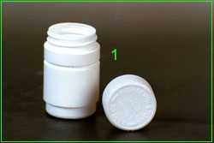
1 | 385 | Capsule box with child proof cap

Slide 27
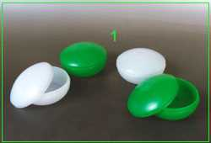
1 | 469 | Box of cream (oval)

Slide 28
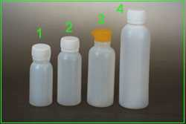
1 | 472 | Antibiotic bottle 60 cc with proof cap.
2 | 471 | Antibiotic bottle 80 cc with proof cap.
3 | 455 | Antibiotic bottle 150 cc with proof cap.
4 | 479 | Antibiotic bottle 200 cc with proof cap.

Slide 29
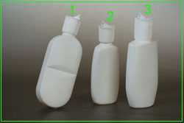
1 | 477 | Filling bottle 120 cc with spout cap
2 | 460 | Filling bottle 75 cc with spout cap
3 | 461 | Filling bottle 125 cc with spout cap

Slide 30
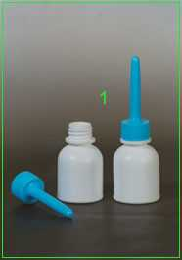
1 | 438 | Filling bottle 30cc with spout cap (capsule shape)

Slide 31
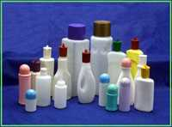
Cosmetic packing

Slide 32
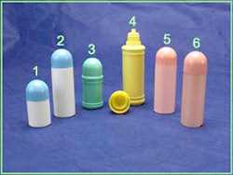
1 | 390 | Tubular bottle 40 cc with cap & dropper
2 & 5 & 6 | 391 | Tubular bottle 60 cc with cap & dropper
3 | 374 | Tubular bottle 60 cc with cap & dropper
4 | 398 | Tubular bottle 120 cc with cap & dropper
1 | 390 | Tubular bottle 40 cc with cap & dropper
2 & 5 & 6 | 391 | Tubular bottle 60 cc with cap & dropper
3 | 374 | Tubular bottle 60 cc with cap & dropper
4 | 398 | Tubular bottle 120 cc with cap & dropper

Slide 33
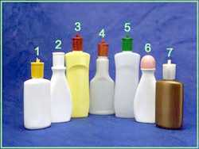
1 & 7 | 429 Shampoo bottle 150 cc with spout cap
2 | 422 Shampoo bottle 175 cc with spout cap
3 & 5 | 382 Shampoo bottle 300 cc with spout cap
4 | 379 Shampoo bottle 180 cc with spout cap
6 | 423 Shampoo bottle 175 cc with cap & dropper

Slide 34
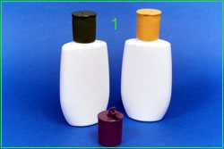
1 | 461 | Shampoo bottle 125 cc with spout cap

Slide 35
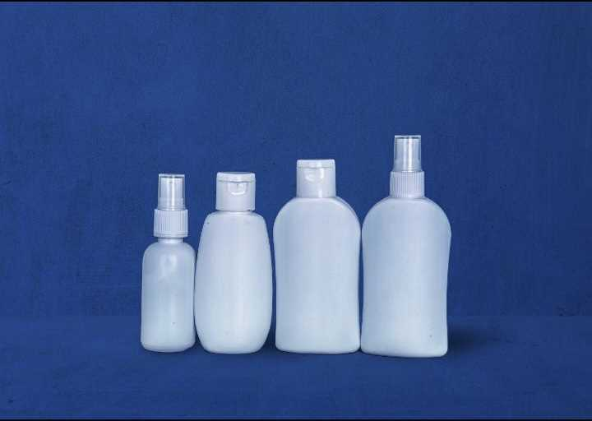
1 | 532 | Sprayer bottle 100 ml
2 | 532 | Shampoo bottle 100 ml with flip top cap
3 | 460 | Shampoo bottle 100 ml with flip top cap
4 | 435 | Shampoo bottle 100 ml with flip top cap

Slide 36
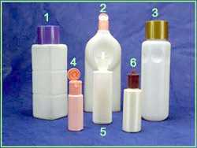
1 | 428 | Square shampoo bottle 1 liter with screw cap
2 | 429 | Shampoo bottle 1 liter with flip cap
3 | 383 | Shampoo bottle 1 liter with screw cap
4 | 399 | Shampoo bottle 60 ml with flip cap
5 | 381 | Shampoo bottle 250 ml with spout cap
6 | 421 | Shampoo bottle 150 ml with spout cap

Slide 37
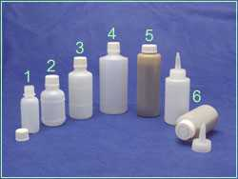
1 | 324 | Filling bottle 30 ml with dropper & screw cap
2 | 325 | Filling bottle 60 ml with dropper & screw cap
3 | 326 | Filling bottle 100 ml with dropper & screw cap
4 | 327 | Filling bottle 200 ml with dropper & screw cap
5 | 452 | Cylindrical bottle 120 ml with screw cap & spout
6 | 445 | Cylindrical bottle 80 ml with screw cap & spout

Slide 38
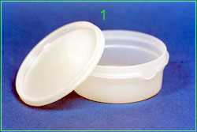
1 | 459 | Plastic box with cap 130 gm

Slide 39
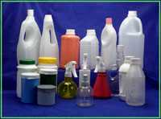
Wide use Packing

Slide 40
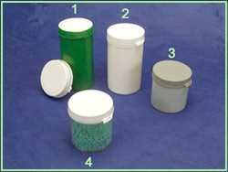
1 | 462 | Plastic box 450 gm with proof cap
2 | 394 | Plastic box 450 gm with proof cap
3 | 424 | Plastic box 250 gm with proof cap made of P.E.
4 | 425 | Plastic box 250 gm with proof cap made of P.S.

Slide 41
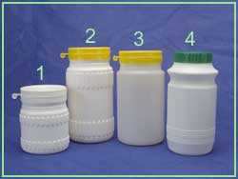
1 | 376 | Plastic jar 0.5 kg with proof cap
2 | 377 | Plastic jar 1 kg with proof cap
3 | 466 | Plastic jar 1 kg with proof cap
4 | 362 | Plastic jar 1 kg with screw cap

Slide 42
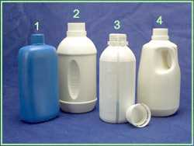
1 | 408 | Jar 750 ml with screw cap
2 | 400 | Cylindrical jar 1 liter with proof cap
3 | 412 | Jar 500 ml with proof cap
4 | 401 | jar 1 liter with proof cap

Slide 43
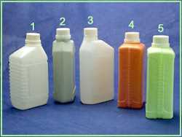
1 | 402 | Jar 1 liter with proof cap
2 & 3 | 407 | Jar 1liter graded with window strap & proof cap
4 & 5 | 403 | Jar 1 liter graded with window strap & proof cap

Slide 44
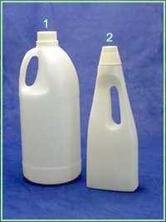
1 | 405 | Cylindrical bottle 3 liter with proof cap
2 | 411 | Bottle 800 ml with cap

Slide 45
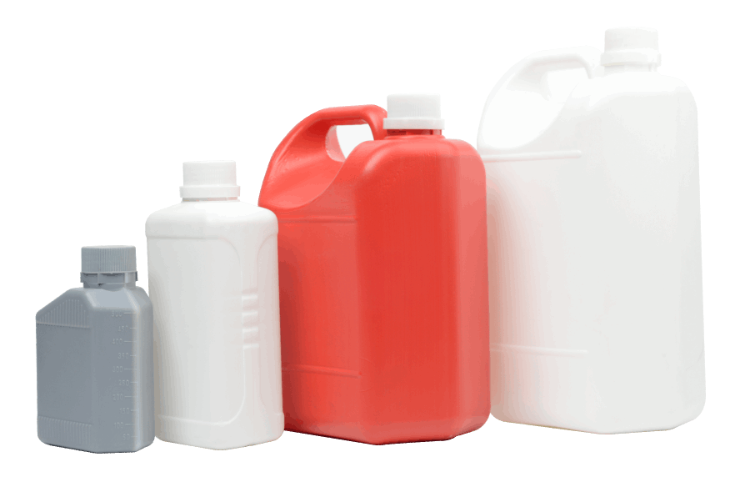
1 | 535 | Jerry can 5 liter
2 | 534 | Jerry can 4 liter
3 | 403 | Jar 1liter graded with window strap & proof cap
4 | 495 | Jar 1/2 liter graded with window strap & proof cap

Slide 46
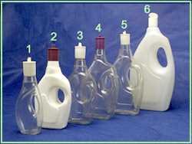
1 | 378 | Bottle 125 ml with spout cap
2 | 443 | Jar 250 ml with spout cap
3 | 442 | Jar 500 ml with spout cap [available in PVC or PE ]
4 | 441 | Jar 750 ml with spout cap
5 | 440 | Jar 1 liter with spout cap
6 | 404 | Jar 1.7 liter with flip cap

Slide 47
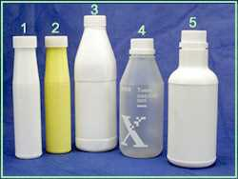
1 & 2 | 451 | Cylindrical bottle 260 ml with screw cap
3 | 437 | Square bottle with screw cap
4 | 414 | Conical bottle 700 ml with proof cap
5 | 445 | Cylindrical bottle 800 ml with proof cap

Slide 48
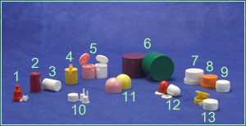
1 | 522 | Proof cap for dropper bottles
2 & 3 | 431 | Cap for aerosol cans
4 | 239 | Cap spout
5 | 244 | Flip top cap
6 | 217 | Cap for shampoo bottle
7 | 236 | Proof cap large
8 | 235 | Proof cap medium
9 | 215 | Proof cap small
10 | 519 | Cap &self dropper for glass bottles
11 | 243 | Round cap
12 | 502 | Cap & ring for cream tubes
13 | 241 | Proof cap soft

Slide 49
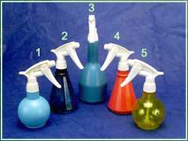
1 | 393 | Sprayer round (PE)
2 | 388 | Sprayer conical (PC)
3 | 336 | Sprayer (PE)
4 | 392 | Sprayer conical (PE)
5 | 389 | Sprayer round (PC)

Slide 50
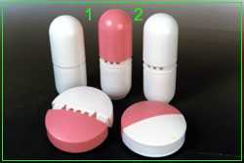
1 | 476 | Air freshener tubular
2 | 475 | Air freshener cylindrical

Slide 51
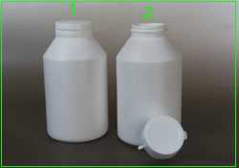
1 | 473 | Jar 400cc with proof cap

Slide 52
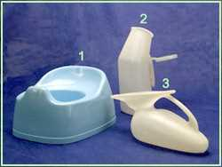
1 | 443 | Baby potty
2 | 338 | Urine bottle for men
3 | 344 | Urine bottle for women

